Slide 1

MBEYA UNIVERSITY OF SCIENCE AND TECHNOLOGY
COLLEGE OF INFORMATION AND COMMUNICATION TECHNOLOGY
DEPARTMENT OF ELECTRONICS AND TELECOMMUNICATION ENGINEERING
TITLE:EXPLAINABLE AI MODEL FOR PULMONARY EDEMA DETECTION IN CHEST X-RAY IMAGES
Student Name: BONIFACE BEN SANKWA
Registration number: 22100934340091
Supervisor: Dr. NYATEGA
TITLE: EXPLAINABLE AI MODEL FOR PULMONARY EDEMA DETECTION IN CHEST X-RAY IMAGES

Slide 2
Background Information
Pulmonary edema is caused by fluid accumulation in the lungs.
It affects breathing and oxygen exchange.
Chest X-rays are commonly used for lung diagnosis.
Manual interpretation is challenging and error-prone.
Deep learning offers automated and accurate detection.
Challenge: AI models often act as “black-boxes”

Slide 3
Problem Statement
Diagnosis depends on skilled radiologists.
Many hospitals lack enough specialists.
Pulmonary edema looks similar to pneumonia.
Manual diagnosis may lead to delays and errors.
Deep learning models lack explainability
Doctors struggle to trust AI predictions

Slide 4
PROJECT OBJECTIVES
Main Objective
To develop an Explainable AI system for detecting pulmonary edema in chest X-ray images, capable of providing diagnostic results along with visual explanations of the regions used for prediction.
Specific Objectives
Study pulmonary edema features in X-ray images.
Collect and preprocess chest X-ray datasets.
Train a CNN model for detection.
Apply Explainable AI techniques.
Evaluate model performance.
Develop a simple web interface to display predictions and heatmaps.

Slide 5
METHODOLOGY
DATA
COLLECTION
PREPROCESSING
MODEL
TRAINING
EVALUATION
EXPLAINABILITY
Agile methodology diagram

Slide 6
Phase Descriptions
PHASE | DESCRIPTION
Data Collection | Chest X-ray images were obtained from Mbeya Regional Hospital.
Preprocessing | Images were resized, normalized, and augmented to improve quality and diversity.
Model Training | A Convolutional Neural Network (CNN) was trained to classify X-ray images.
Evaluation | Performance was assessed using accuracy, sensitivity, specificity, and AUC metrics.
Explainability | Visualization techniques such as Grad-CAM were applied to interpret model decisions.

Slide 7
TOOLS AND TECHNOLOGY
Programming Language : Python
Framework & Libraries
TensorFlow & Keras
OpenCV
Matplotlib
Grad-CAM
Hardware Environment : Laptop
Dataset source
Mbeya Regional Hospital
Public Medical Archives
Notes:
Frameworks & Libraries
TensorFlow & Keras → Model building and training.
OpenCV → Image preprocessing (resizing, normalization).
Matplotlib & Seaborn → Graphical analysis and visualization.
Grad-CAM → Explainability through heatmaps.
Visualization Tools
Grad-CAM → Interpretability maps.
Matplotlib → Charts and graphs for dataset distribution and accuracy
Microsoft Excell

Slide 8
DATA COLLECTION AND ANALYSIS
DATA COLLECTION
Category | Number of Images | Source | Description
Pulmonary Edema | 40 | Mbeya Regional Hospital | X-ray images showing fluid accumulation in lungs
No Edema | 40 | Mbeya Regional Hospital | Normal chest X-ray images without edema
Supplementary Data | 20 | Public Medical Archives | Additional samples for model validation

Slide 9
DATA ANALYSIS

Slide 10
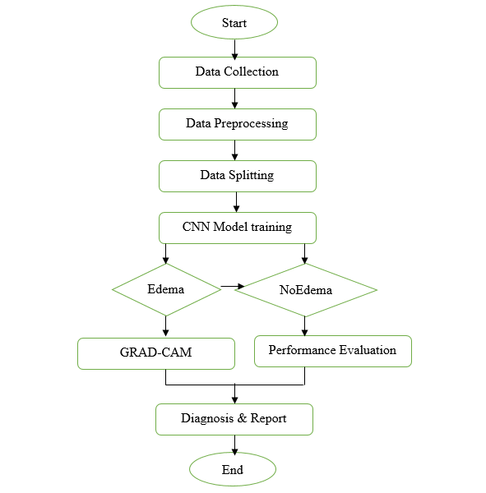
FLOWCHART DIAGRAM

Slide 11
THANK YOU

